Slide 1


Docker Kubernetes

Slide 2

Vagrant
Vagrant
It leverages a declarative configuration file which describes all your software requirements, packages, operating system configuration, users, and more.
Vagrant aims to mirror production environments by providing the same operating system, packages, users, and configurations, all while giving users the flexibility to use their favorite editor, IDE, and browser.
Vagrant works on Mac, Linux, Windows, and more.

Slide 3




Vagrant Providers
Vagrant
VirtualBox
Vmware
Docker
Hyper-v
libvirt (on LXC, KVM/QEMU, Xen, VMWare ESX)

Slide 4
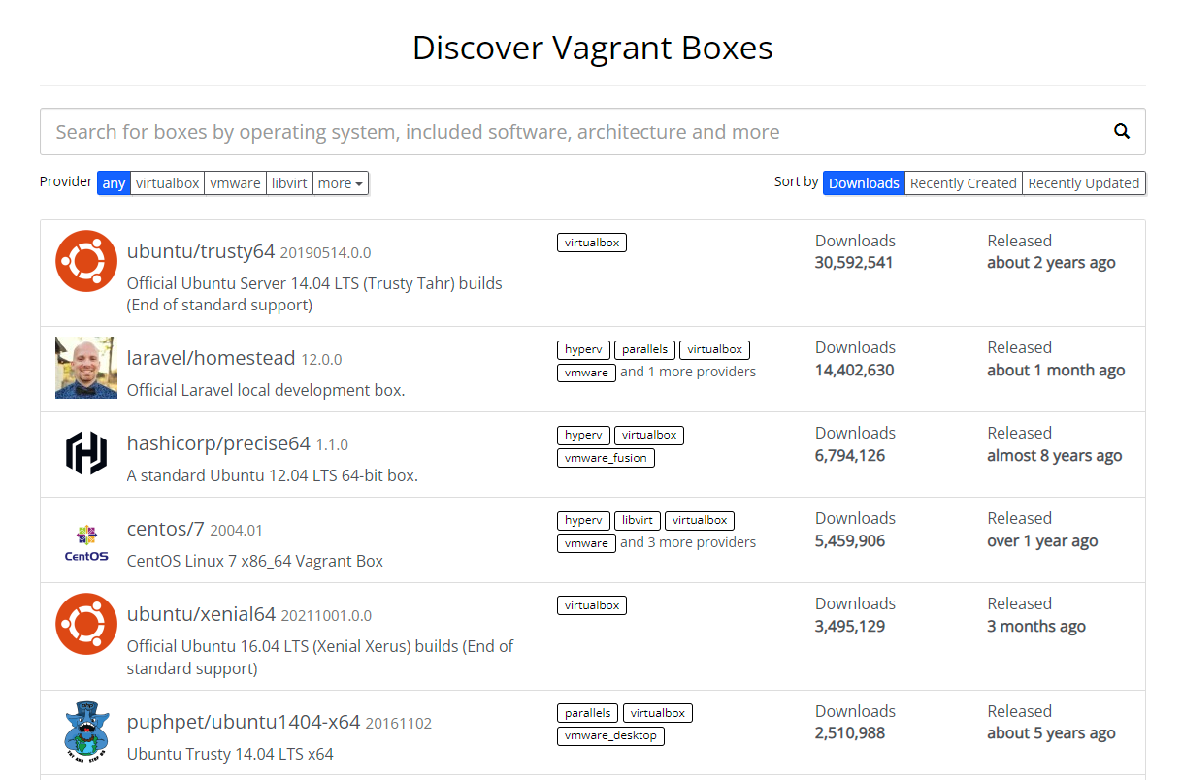
Vagrant Boxes
Vagrant
Base OS, Base OS + packages
(Box Search) https://app.vagrantup.com/boxes/search

Slide 5
Box Provision Procedures
Vagrant
Vagrant 초기화(vagrant init)
설정 변경(Vagrantfile)
가상머신 power on(vagrant up)
가상머신 접속(vagrant ssh <가상머신 이름>)
가상머신 power off(vagrant halt <가상머신 이름>)
가상머신 삭제(vagrant destroy <가상머신 이름>)
(Box Search) https://app.vagrantup.com/boxes/search

Slide 6
Vagrantfile 설정
Vagrant
$ cd docker-k8s-hands-on/lab/day1/lab4
$ vagrant init
$ vi Vagrantfile
$ vagrant up
# VirtualBox 에서 생성된 가상머신 확인
# 또는
$ vagrant status Current machine states:
default running (virtualbox)
The VM is running. To stop this VM, you can run `vagrant halt` to
shut it down forcefully, or you can run `vagrant suspend` to simply
suspend the virtual machine. In either case, to restart it again,
simply run `vagrant up`.
# 가상머신 진입
$ vagrant ssh default
$ cat /etc/redhat-release
# -*- mode: ruby -*-
# vi: set ft=ruby :
# All Vagrant configuration is done below. The "2" in Vagrant.configure
# configures the configuration version (we support older styles for
# backwards compatibility). Please don't change it unless you know what
# you're doing.
Vagrant.configure("2") do |config|
# The most common configuration options are documented and commented below.
# For a complete reference, please see the online documentation at
# https://docs.vagrantup.com.
# Every Vagrant development environment requires a box. You can search for
# boxes at https://vagrantcloud.com/search.
config.vm.box = "bento/centos-7.7"
Vagrant 계정의 Password는 vagrant https://www.vagrantup.com/docs/boxes/base#default-user-settings
(주의) PowerShell에서는 커맨드가 정상 작동하나 WSL Ubuntu 20-04 쉘에서는 vagrant 를 설치해야 한다.

Slide 7
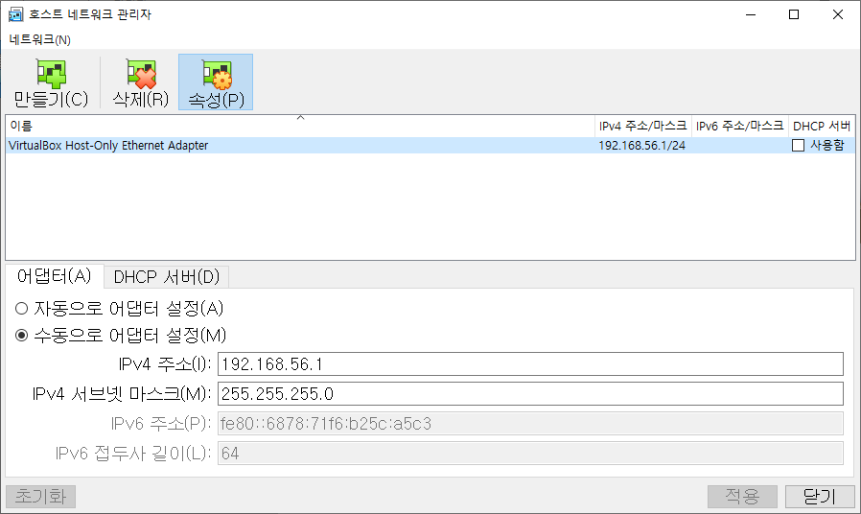
(!) 호스트 네트워크가 작동하지 않을 때
Vagrant
Oracle VM VirtualBox 관리자에서
파일 -> 호스트 네트워크 관리자 선택
DHCP 서버 : 사용함 언체크
IPv4 주소 : 192.168.1.1
(주의) Vagrant 로 생성되는 VM의 경로는 저장공간이 충분한 별도의 디스크 사용을 권장한다. https://software-craftsman.tistory.com/291

Slide 8
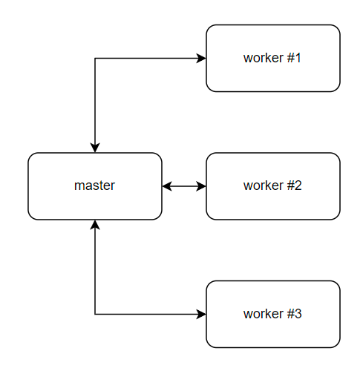
k8s 노드 구성
Vagrant
# (권장) vagrant hostmanager plugin 설치
$ vagrant plugin install vagrant-hostmanager
$ vagrant plugin install vagrant-vbguest
# k8s 클러스터 구축
$ cd docker-k8s-hands-on/lab/day1/lab4
$ vagrant up
…(20분 정도 소요)…
# k8s 클러스터 확인
$ vagrant ssh m1-k8s.snetsystems.co.kr
$ sudo su –l
$ kubectl get nodes

